Slide 1
ADVERTISEMENTS
1. Analyze by answering the 5 CRITICAL RESPONSE QUESTIONS
2. Decide if these ads are
EFFECTIVE or NOT EFFECTIVE
for certain audiences

Slide 2
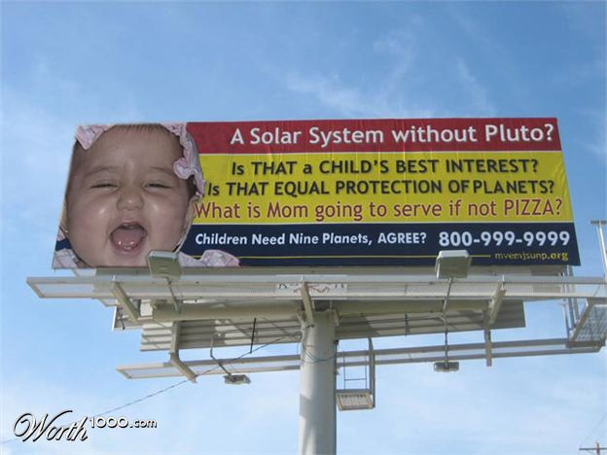

Slide 3
“I don't think this advertisement is effective because at first I didn't get it(the pizza bit). And if it's on a billboard next to a road, people are going to drive past and not bother thinking about it once they've realized they might actually have to think about it(to get it). Also, who wants to call a strange number to agree that the solar system needs nine planets?”

Slide 4
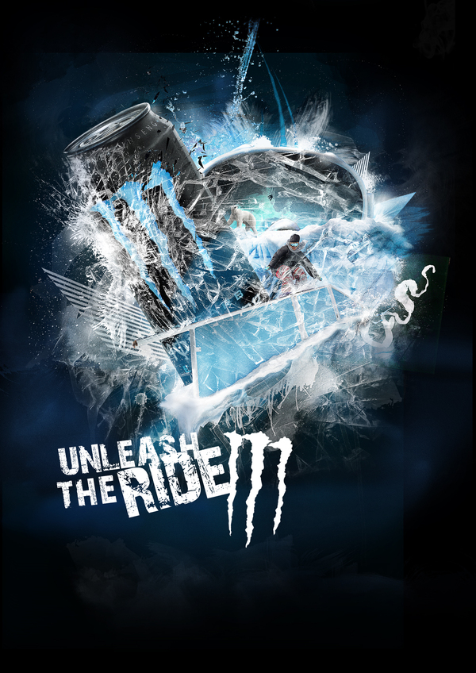
Notes:
“This Monster ad is an ad you would see around the Winter X Games and snowboarding events, etc. It gives the drink a powerful and refreshing look by showing it crush through the ice. It unleashes itself in the image and on the tagline is ” unleash the ride” implying that if you drink monster you will get that rush and that boost of energy that you need. I think this is a great idea for an ad”

Slide 5
“This Monster ad is an ad you would see around the Winter X Games and snowboarding events, etc. It gives the drink a powerful and refreshing look by showing it crush through the ice. It unleashes itself in the image and on the tagline is ” unleash the ride” implying that if you drink monster you will get that rush and that boost of energy that you need. I think this is a great idea for an ad.”

Slide 6
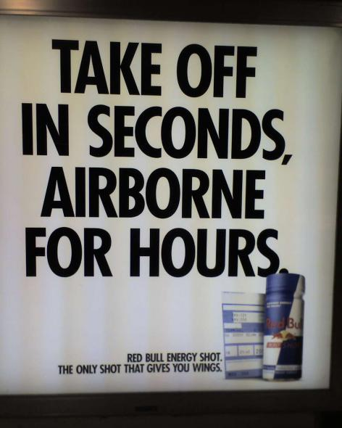

Slide 7
“I think that this advertisement is effective because it describes in a metaphorical sense that Red Bull 'gives you wings'. Aka- it gives you a lot of energy. The heading of this advertisement 'take off in seconds, airborne for hours' is basically saying that it makes you feel energetic for a long period of time, but being worded the way it is shows that it is aimed at a younger audiences(15-30 years of age).”

Slide 8
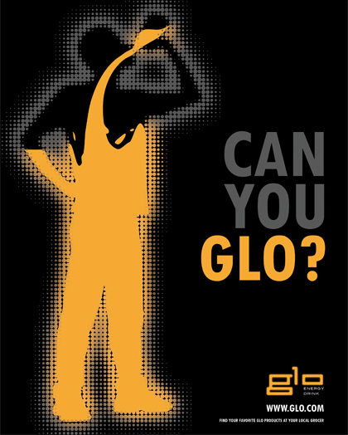

Slide 9
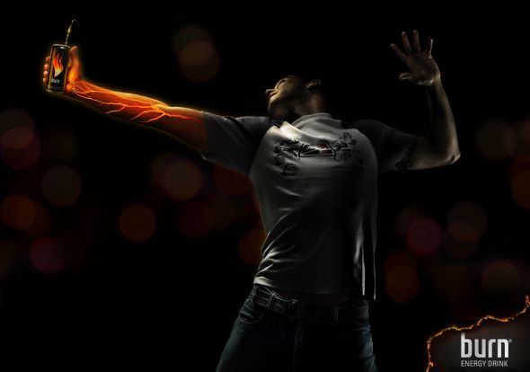

Slide 10
“This print ad for Glo energy drinks is very similar to the Burn energy drink ads where it shows the person drinking it and it taking over their body to give them the energy that they need. I don’t think this ad is a good ad because it is very similar to the Burn ad and it is too simple and doesn’t really say much about the product.”
“This ad is a great ad because it represents the drink as being so powerful in energy that it goes right through your veins. It is the graphic image that makes the ad powerful looking because it looks real.”

Slide 11
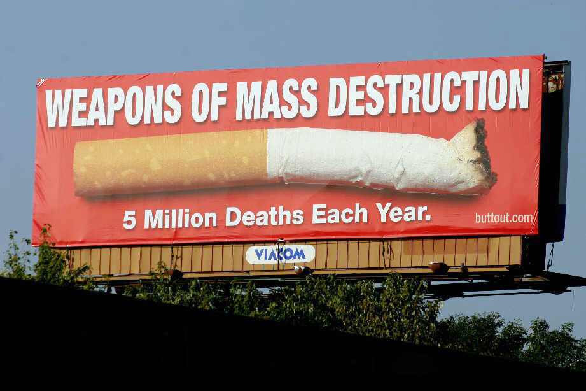

Slide 12
“I don't believe this advertisement is effective because the quote on the billboard; 'weapons of mass destruction' is the type of quote that you would find on a billboard advertising a film. I also believe that the giant image of a cigarette butt and the fact down the bottom; '5 million deaths each year' would not encourage anyone to go out of their way to give up their addiction. Frankly I think the advertisement is too...boring?”

Slide 13
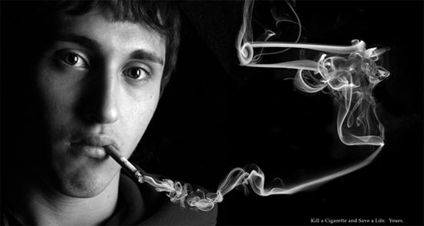

Slide 14
“This is a much better advertisement than the previous cigarette advertisement. It shows directly what may happen to you if you smoke (as in die; not get shot in the head). The cigarette smoke makes a fantastic representation of a gun which is pointed at the smokers head to suggest that you indeed may die from smoking cigarettes.”

Slide 15
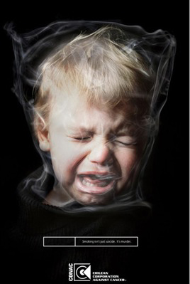

Slide 16
Target Audience:
“The target audience for this advertisement would be anyone or more particularly parents who smoke.”
Message:
“The message I feel this advertisement is trying to get across is that smoking around children can be just as bad as the child smoking itself, secondary smoke around a child can be suffocating.”
How The Message is Communicated To Target Audience:
“The message is communicated through an image of a small child with a bag shape over its head that has been rested by smoke, making it look like the child is being suffocated by the smoke as it would be if it were a plastic bag.”
Effective or Not Effective Advertisement:
“I think this is a very effective advertisement as I feel it gives a very strong message about smoking around children and the damages it can do if a smoker was to smoke around young children, it also shows you the damage that can’t normally be seen. I think because of the strong and clear message it puts across, this is why it is an effective advertisement as I believe it would make some people stop and think of the damage they are causing to others, especially their children.”

Slide 17
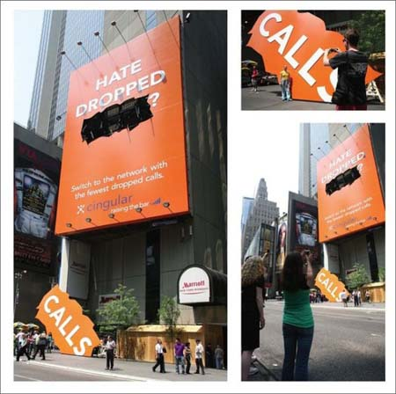

Slide 18
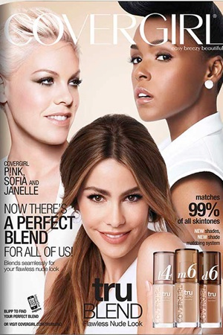

Slide 19
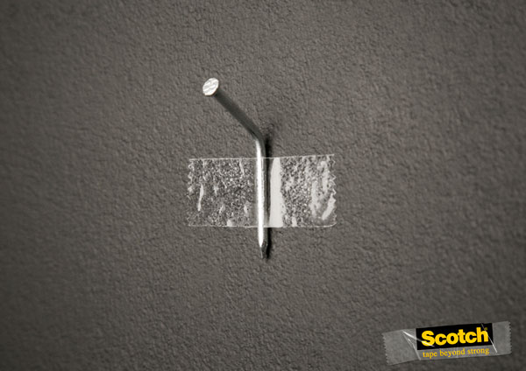

Slide 20
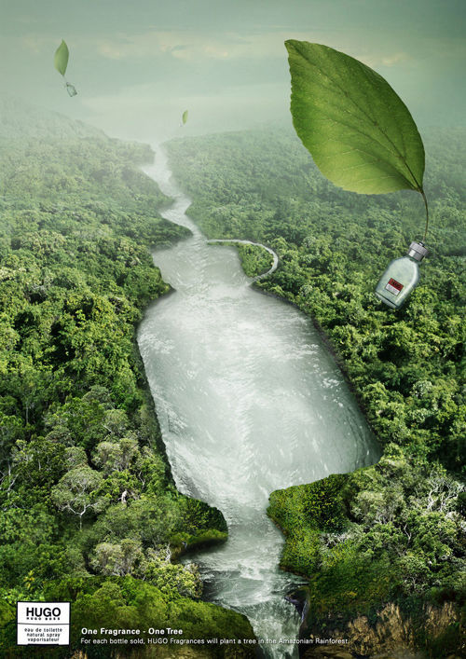

Slide 22
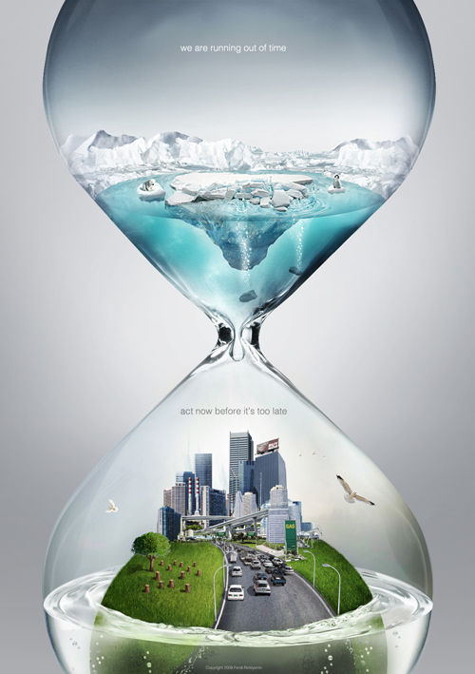

Slide 23
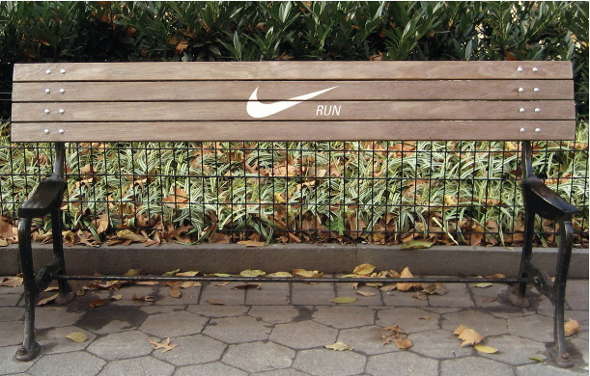

Slide 24
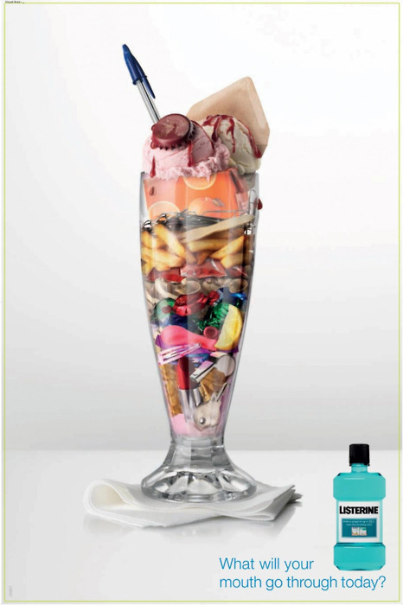

Slide 25
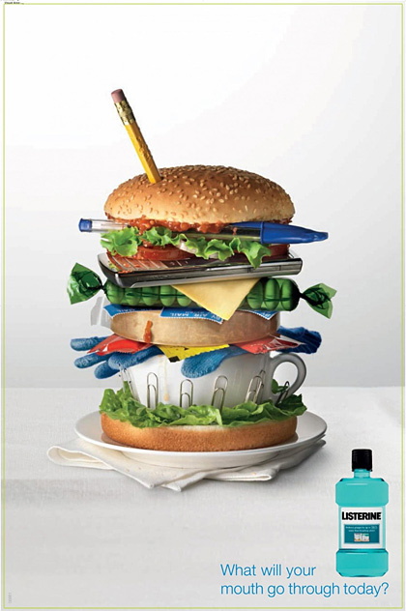

Slide 27
“The key to their successful advertising lies within their tactics involving logos, pathos, and ethos. The commercial kicks off with Taylor Swift, an iconic star of the present, emerging from bright green silk currents “introducing a breath of fresh air.” This very scene played in the first two seconds of the commercial appeals to our logos in that it takes our commonplace that freshness and nature are greatly valued now due to the current green initiative.
We view a popular idol asking females to take part in that green initiative by buying a product that has a sense of eco-friendliness. This sense is derived from the point Taylor mentions when she informs viewers that CoverGirl took out the “heavy synthetic” and put in light cucumber. The negative connotation society places upon such words like synthetic or processed appeals to our logos as we are convinced that we will using a more acceptable product in purchasing Naturluxe foundation.
In addition, the point the ad makes in acknowledging the cost efficiency of the product appeals to our logos as well since society tends to favor cost effective products.
Moreover, the advertisement intrigues the audience through pathos. Specifically the ad features a montage of Taylor Swift floating and dancing around while wearing the advertised foundation. This image portrays happiness, satisfaction of body image, and overall femininity (all emotions or states that women would want to feel since our society praises such emotions/states).
Finally, the commercial appeals to our ethos through the use of Taylor Swift being its featured promoter. The very character of Taylor Swifts allures audiences into believing that such a product must be worth while if the Taylor Swift is advocating buying the make-up. We associate Taylor Swift with beauty, success, and an overall positive image. Therefore we are more likely to spend money on a product she specifically endorses.
Ultimately, CoverGirl has mastered their techniques in advertising their products to audiences ranging from preteen girls to adult women.”

